Slide 1
Computer Organization Architecture
SEMESTER PROJECT:
Designing of processor using Verilog
Using MIPS Architecture

Slide 2
MIPS-ARCHIETECTURE:
- The MIPS (Microprocessor without Interlocked Pipeline Stages) architecture is a reduced instruction set computer (RISC) architecture widely used in embedded systems, workstations, and supercomputers.
- It was developed by John L. Hennessy and his team at Stanford University in the 1980s.
- MIPS is known for its simplicity, efficiency, and scalability, making it a popular choice for educational purposes and real-world applications.
.
- MIPS architecture is extensively used in education, embedded systems, networking, and digital signal processing, due to its simplicity, efficiency, and well-defined instruction set.

Slide 3
- Key features of the MIPS architecture include:
RISC Principles
Load-Store Architecture
Fixed Instruction Length
Pipelining
Delayed Branching.
32-bit Architecture
Register File

Slide 4
Basic elements:
Program Counter: Implements a program counter module that increments the count on each clock cycle.
BitAdder32: Implements a 32-bit adder module.
Register File: Implements a register file module that stores and retrieves data based on the provided addresses.
Instruction Memory: Implements an instruction memory module that stores instructions and retrieves them based on the provided address.
Data Memory: Implements a data memory module that allows read and write operations to specific memory addresses.
SignExtender_16to32: Implements a sign extender module to extend a 16-bit input to a 32-bit output by sign extension.
ALU_32bit: Implements a 32-bit ALU module that performs various arithmetic and logical operations based on the control signals.

Slide 5
Multiplexer5bit: Implements a 5-bit multiplexer module.
Multiplexer32bit: Implements a 32-bit multiplexer module.
IF_ID Register: Implements a pipeline register between the instruction fetch (IF) and instruction decode (ID) stages.
ID_EX Register: Implements a pipeline register between the instruction decode (ID) and execute (EX) stages.
EX_MEM Register: Implements a pipeline register between the execute (EX) and memory (MEM) stages.
MEM_WB Register: Implements a pipeline register between the memory (MEM) and write-back (WB) stages.
Control Unit: Implements a control unit module that generates control signals based on the opcode and function fields of an instruction.
Control Delay Slot: Implements a control delay slot module that delays the execution of instructions following a branch until the branch is resolved.

Slide 6
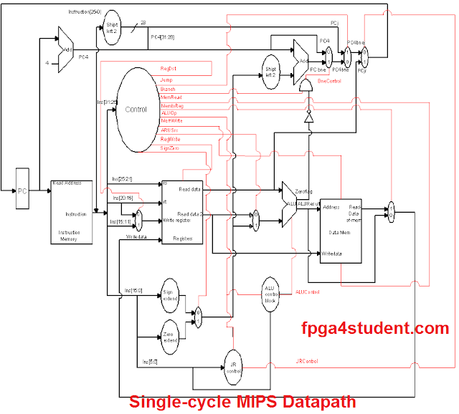
TASK 01
Datapath
Control unit
Main module

Slide 7
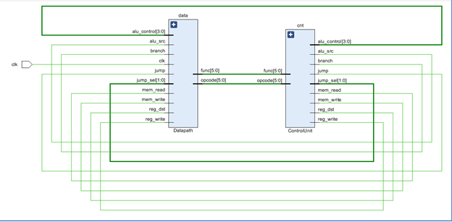
SCHEMATIC:

Slide 8
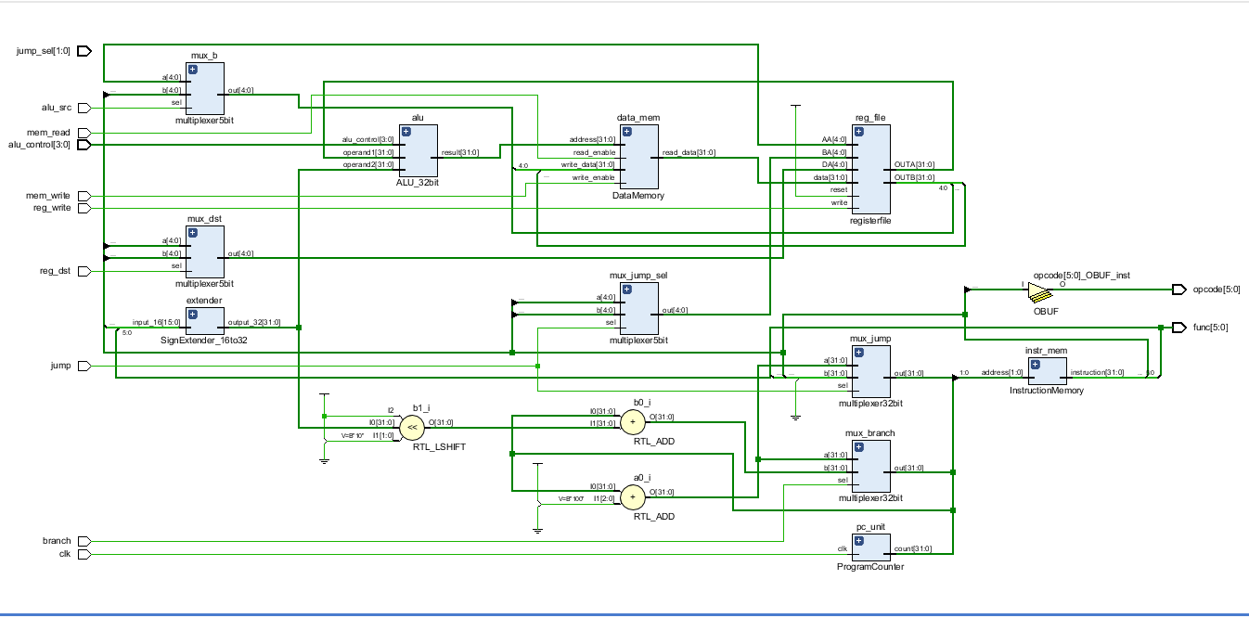
Datapath

Slide 9
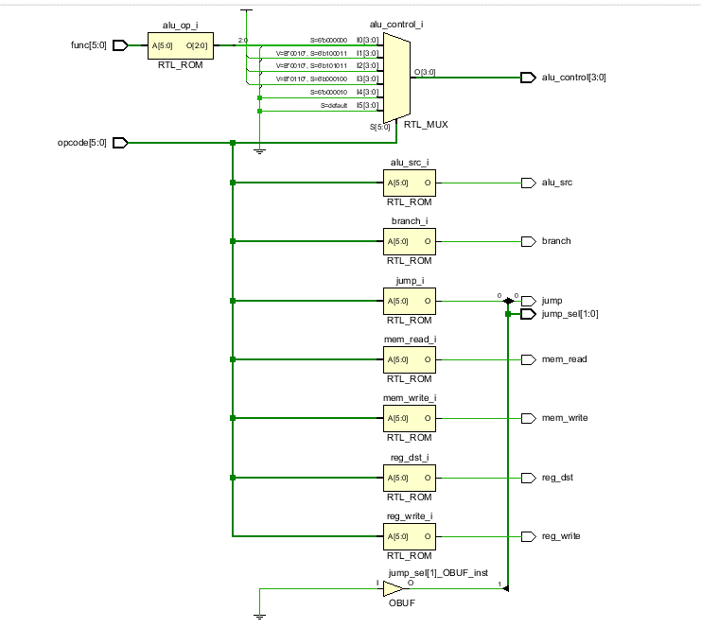
Control

Slide 10
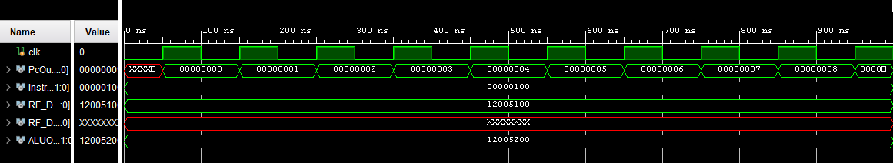
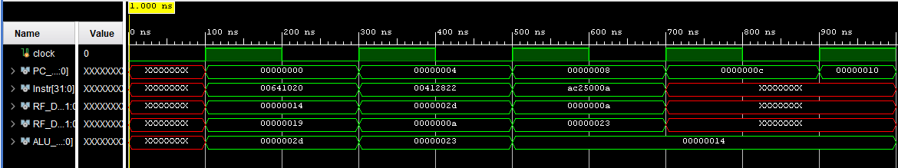
Output:

Slide 11
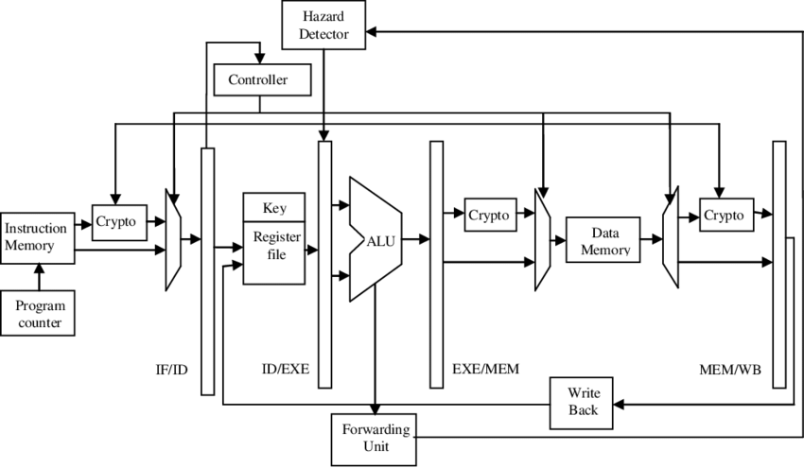
TASK02

Slide 12
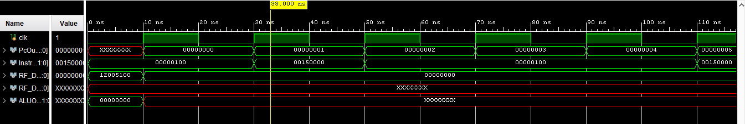
IF/ID
ID/EX
EX/MEM
MEM/WB

Slide 13
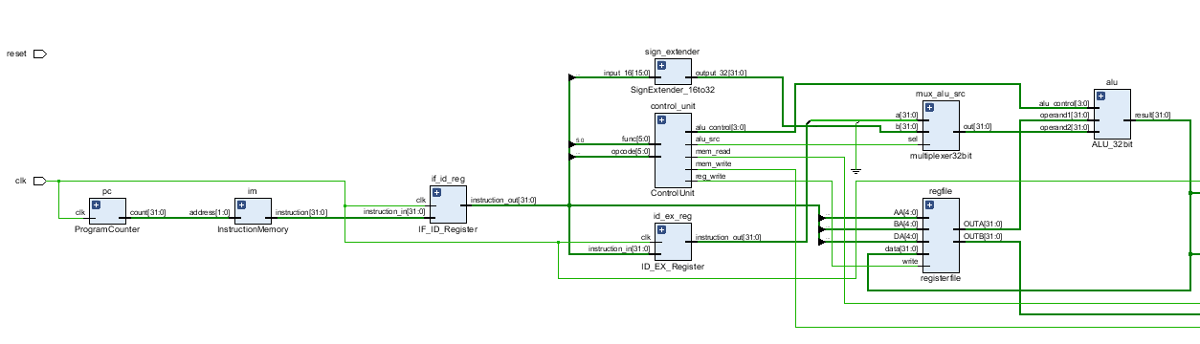

Slide 14
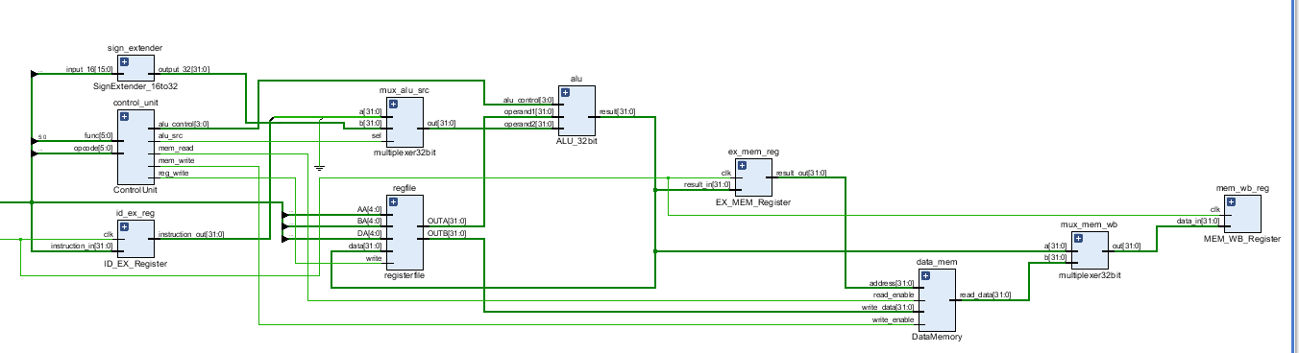

Slide 15
TASK03
forwarding unit
control hazard removal unit
load instruction hazard removal unit
structural hazard removal unit

Slide 16
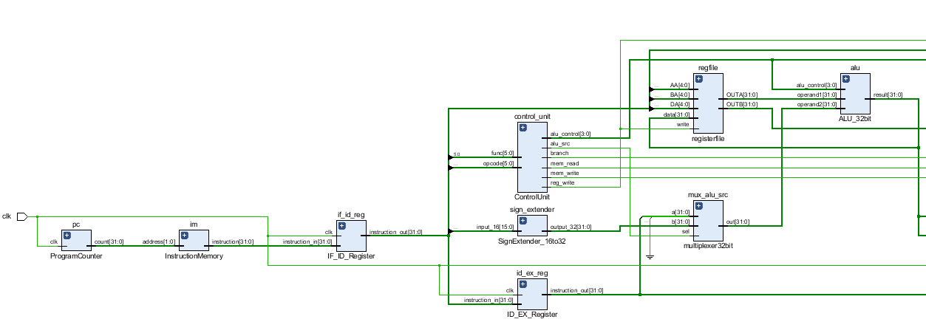

Slide 17
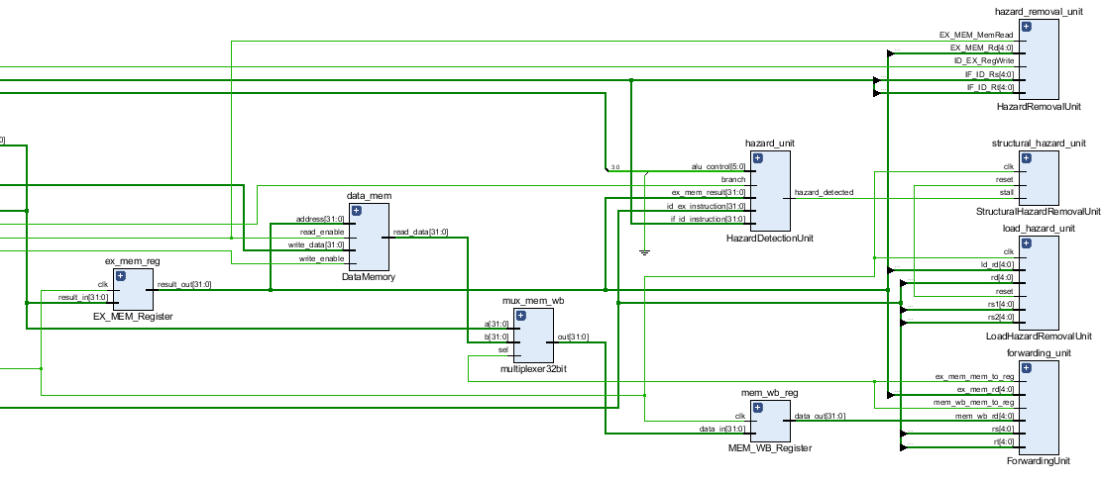

Slide 18
OUTPUT:

Slide 19
Advantages of a pipelined architecture over a simple MIPS architecture:
1. Increased throughput
2. Improved performance
3. Efficient resource utilization
4. Reduced instruction latency
5. Enhanced instruction throughput
6. Better scalability
7. Effective branch handling
8. Support for complex instructions
9. Flexibility in design
10. Widely adopted

